Slide 1



G.Narayanamma Instituite of Technology and Science
SIGN LANGUAGE DETECTION

Slide 2
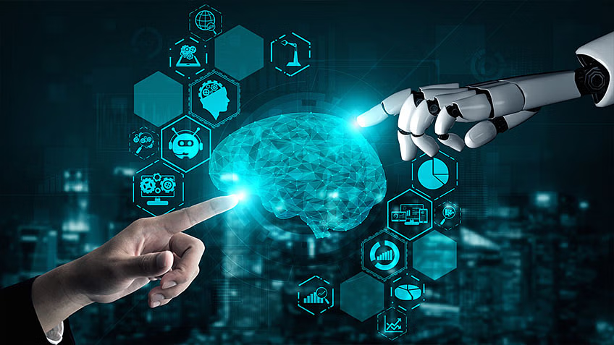
1
BY:
P.Sanjana-22251A05J0
V.Nikhitha-22251A05J9
T.Supriya-22251A05J8
K.Keerthi-23255A0518
Batch No: C13
Guide:Mrs.B.Spandana
Branch:CSE

Slide 3



INTRODUCTION:
Real-time sign language detection using deep learning.
Bridges communication gap between sign language
users and others.
Customized models ensure accurate recognition
across variations.
Adaptable to various devices for widespread
accessibility.
User-friendly interface promotes natural and
meaningful interactions.

Slide 4

Literature Survey
Problem Statement | Research Papers | Disadvantages
Developing a CNN-based solution to automatically recognize and interrupt sign language gestures in real-time addressing the need for more accurate and efficient communication tools for this community. | Sign Language recognition System using CNN (Publisher:IEEE) | It cannot recognize gestures if the background is cluttered
 | Sign language Translation system based on Deep Learning. (Publisher:IEEE) | Limited Training Data

Slide 5



Problem Statement
Developing a CNN-based solution to
automatically recognize and interrupt sign language gestures in real-time addressing the need for more accurate and efficient communication tools for this community.

Slide 6
Existing System
The existing systems datasets contain less number of gestures for detection .The existing Indian Sign Language Recognition systems are designed using machine learning algorithms with single-double handed gestures but they are not real -time . Few of them could not recognize the gesture if the background is cluttered and the t

Slide 7
Proposed Systems
Our proposed system aims to enhance sign language detection using CNNs. We plan to expand the dataset with more diverse sign language images to improve model performance and generalization. To tackle cluttered backgrounds, we'll employ preprocessing techniques and data augmentation methods. Our CNN architecture is designed to adapt to cluttered environments, ensuring robust performance. Evaluation metrics will include accuracy, precision, recall, and F1-score. Anticipated benefits include improved accuracy in detecting sign language gestures, enhancing accessibility for individuals with impairments.

Slide 8
Objectives
To facilitate communication between signers and non-signers by translating sign language into text .
To enhance accessibility by developing user-friendly applications, such as web apps, for individuals with speech disabilities .
To deliver a system for Realtime sign language detection and recognition using Computer Vision.
And the training of model using CNN.

Slide 9

Software Requirements
Python deep learning frame works
Open CV
CNN
Tensor flow
Keras
Hardware Requirements
Computer
Webcam

Slide 10

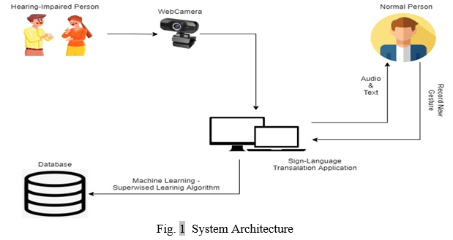

System Architecture

Slide 11
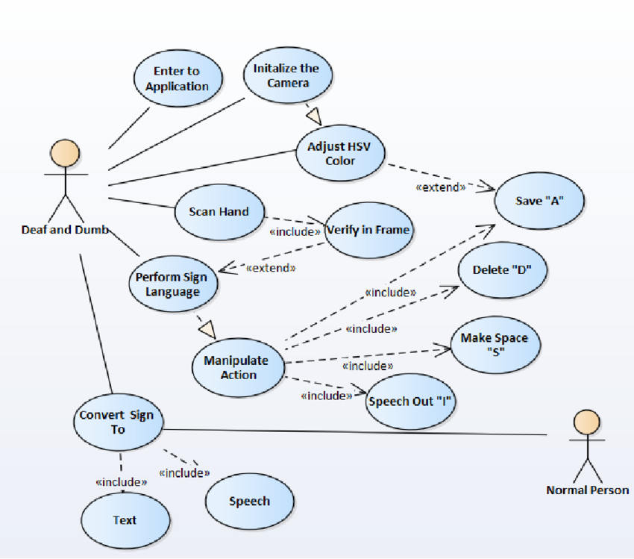
Design

Slide 12


References
1.https://ieeexplore.ieee.org/document/10091051
(ieee paper on sign language recognition system using CNN)
2.https://ieeexplore.ieee.org/document/8950864
(ieee paper on research of a sign language translation system based on deep learning )

Slide 13


Thank you!

